Slide 1
Towards Efficient Querying of Rich Video Content
Maureen Daum
Notes:
- Make slide white and don't use white background
- Or find "W" square logo

Slide 2
Motivation
We want to enable rich, content-based queries over video data
Existing systems optimize running object detection over videos
As a result, they focus on simple queries only
We want to use this metadata to enable more complex queries
Notes:
Cameras are everywhere nowadays, and they generate much video data.
Videos inherently consists of pixel values, but they can be augmented with richer information about what the video contains. We consider this richer information to be metadata
Systems like BlazeIt are making it faster to run neural networks over videos and automatically generate metadata.
As an example, say you’ve run object detection over all of the frames in your video. Maybe you know the video only contains cats, so to debug your model you could want to look only at frames that the model classified to contain non-cat objects.

Slide 3
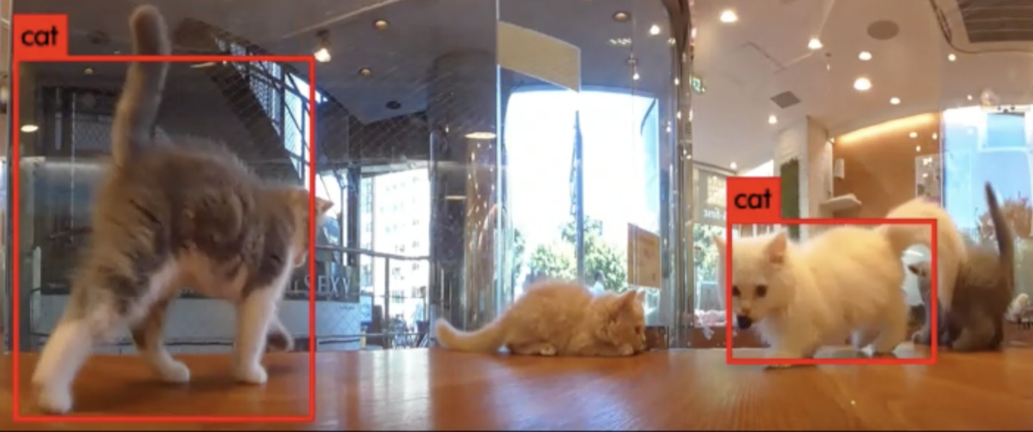
Metadata
Object labels
Weather conditions
Descriptions
License plate numbers
Aggregates
Notes:
Some examples of types of metadata could be object labels or identifiers, weather conditions, descriptions of what is happening in the video, license plate numbers for the surveillance videos, or aggregates about the contents of the video, such as ”vehicles per frame”.

Slide 4
SELECT pixels FROM video WHERE dog
Notes:
Now let’s look at some example queries.
Due to time we are only going to go in depth for the optimizations for select queries like this one, but we are working on the rest

Slide 5
Overlay the dog pixels from video 1 onto the background in video 2

Slide 6
Select sequences of frames that contain increasing numbers of cats
Notes:
The first problem to address is now that we have the metadata, how do we store it?

Slide 7
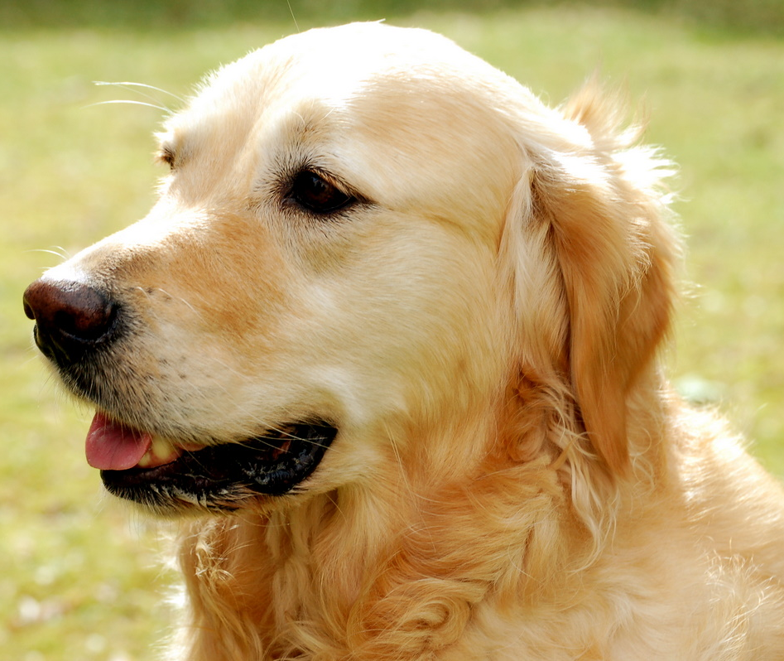
Metadata Model
t
Label | Volume
Dog | $$\left[t_{0},t_{1}\right], \left[x_{0},x_{1}\right], [y_{0},y_{1}]$$
y
x
Notes:
Let’s take the object recognition case, for example. The metadata it generates are labels associated with regions of the video. We create a relational table that has one or more columns for the metadata-specific information. In this case it’s a label, but for other types of metadata there could be multiple columns. There is also a column for the volume associated with the metadata.
I am oversimplifiying this here because we actually consider a larger space.
Now that we know how the metadata is actually stored, we can consider how to execute the queries.

Slide 8
Executing Queries
Videos are stored in a compressed format
Encoding and decoding are expensive operators
Notes:
Now that we know how the metadata is stored, we can look at how to execute queries over the videos and metadata.
We execute queries over compressed videos. This is required because due to the large quantity of video data, it is infeasible to store it all as raw frames. For example, youtube has over 500,000 hours of video uploaded every day. Storing this quantity of videos as raw frames would consume pedabytes of storage, but by compressing videos you can achieve ~100x space reduction. Operating over raw frames is not a feasible option. The codecs used to perform the compression also are not flexible as they are built into hardware, so we have to work with them.
Because we are performing queries over compressed videos, decoding the video to get the raw frames and re-encoding the processed video take a significant portion of the query time.
Drawing boxes over people is a fairly computationally heavy query compared to selecting frames, but even in that case encoding and decoding take up a significant chunk of the total query time.
Next I’ll talk about some ideas we have to reduce this time.
https://www.businessinsider.com/viewers-find-objectionable-content-on-youtube-kids-2017-11

Slide 9
SELECT frames FROM video WHERE dog
This Photo by Unknown Author is licensed under CC BY-SA
Notes:
- First, let’s look at how we might naively run a query to select frames that contain dogs. In this example video showing a worst case, there is only a dog at the last frame, so we have to retrieve that last frame.

Slide 10
SELECT frames FROM video WHERE dog
This Photo by Unknown Author is licensed under CC BY-SA
Notes:
To do this when the video is encoded, we have to decode the frames sequentially.

Slide 11
SELECT frames FROM video WHERE dog
This Photo by Unknown Author is licensed under CC BY-SA
Notes:
The first frame is encoded independently, so we can decode that immediately

Slide 12
SELECT frames FROM video WHERE dog
This Photo by Unknown Author is licensed under CC BY-SA
Notes:
To reduce the size of the compressed video, the following frames are encoded as deltas from the previous frames. This means they have to be decoded in order

Slide 13
SELECT frames FROM video WHERE dog
This Photo by Unknown Author is licensed under CC BY-SA
Notes:
So we proceed through the video decoding each delta

Slide 14
SELECT frames FROM video WHERE dog
This Photo by Unknown Author is licensed under CC BY-SA

Slide 15
SELECT frames FROM video WHERE dog
This Photo by Unknown Author is licensed under CC BY-SA

Slide 16
SELECT frames FROM video WHERE dog
This Photo by Unknown Author is licensed under CC BY-SA

Slide 17
SELECT frames FROM video WHERE dog
This Photo by Unknown Author is licensed under CC BY-SA

Slide 18
SELECT frames FROM video WHERE dog
This Photo by Unknown Author is licensed under CC BY-SA
Notes:
And finally, after decoding the entire video, we get the one frame that we are interested in. We then can encode this dog frame independently and return it.
This sequential scan was very expensive because we spent time decoding frames that we were not interested in.

Slide 19
SELECT frames FROM video WHERE dog
Random access point
Encoded as a delta
This Photo by Unknown Author is licensed under CC BY-SA
Notes:
Now let’s look at a more interesting example where a dog appears in multiple parts of the video. Let’s imagine that the video starts out encoded with one random access point, so the first frame is encoded independently. This is expensive and takes up a lot of storage.
We want to build an index for the frames that contain dogs to make retrieving the frames fast
We can do this by adding random access points, which means that decoding can start at that frame without first decoding the previous frames.
Random access points are expensive because they take up more space, so have to be judicious about adding them
- In this case, only the first frame is a random access point, so we would have to decode the entire video to get the dog in the last frame

Slide 20
SELECT frames FROM video WHERE dog
Random access point
Encoded as a delta
This Photo by Unknown Author is licensed under CC BY-SA
Notes:
Adding random access points to every dog would make performing the query very fast, but it would increase the storage size too much (especially if dogs appear frequently in the video)

Slide 21
SELECT frames FROM video WHERE dog
Random access point
Encoded as a delta
This Photo by Unknown Author is licensed under CC BY-SA
Notes:
We can use fewer random access points, but still avoid decoding frames that don’t contain a dog. For example if we use the 3 random access points here

Slide 22
SELECT frames FROM video WHERE dog
Random access point
Encoded as a delta
This Photo by Unknown Author is licensed under CC BY-SA
Notes:
To retrieve the dog frames

Slide 23
SELECT frames FROM video WHERE dog
Random access point
Encoded as a delta
This Photo by Unknown Author is licensed under CC BY-SA
Notes:
We can first decode the 3 random access points, which all contain dogs

Slide 24
SELECT frames FROM video WHERE dog
Random access point
Encoded as a delta
This Photo by Unknown Author is licensed under CC BY-SA
Notes:
Then we can decode the final dog frame, which was encoded as a delta from the previous frame which also contained a dog.
By judiciously adding random access points and building indices to interesting frames, we can significantly reduce the amount of the video that has to be decoded.
Adding an index of random access points allows us to reduce the number of frames that we have to decode. The next optimization will allow us to reduce the number of pixels we have to decode

Slide 25
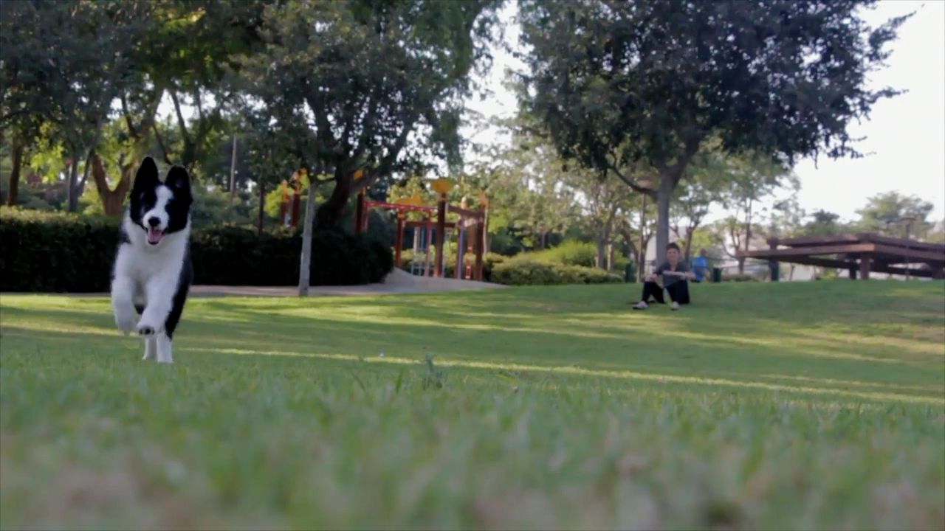
SELECT pixels FROM video WHERE dog
Notes:
This optimization is useful when only parts of a frame need to be operated on. Say we want to select the pixels that contain a dog.

Slide 26
SELECT pixels FROM video WHERE dog
Notes:
We have to decode the frame in raster order, meaning we start at the top-left

Slide 27
SELECT pixels FROM video WHERE dog
Notes:
and work our way down

Slide 28
SELECT pixels FROM video WHERE dog

Slide 29
SELECT pixels FROM video WHERE dog
Notes:
When we finally get to the last dog pixel, we have decoded the majority of the frame. This is wasteful because many of the pixels on the right of the frame don’t contain a dog

Slide 30
SELECT pixels FROM video WHERE dog
Notes:
To reduce the number of uninteresting pixels we have to decode, we can break up the frame into tiles. Each tile is a rectangular region that can be decoded independently.
– So if we use the metadata about where dogs are in the video to come up with a tiling layout, we can avoid decoding non-dog pixels for this query
- This is easy when there is one object in the frame, but once there are multiple objects it becomes more of an optimization problem because adding tiles decreases the decode time, but increases the storage size

Slide 31
Putting Things Together
Similar to DB cracking, incrementally partition the video and add indices
Original Video
Add Metadata
Update Layout
Execute Query
Notes:
Putting everything together, we use ideas from database cracking to incrementally partition the video and add indices.
We ingest videos that are compressed without regard to their contents
As users add metadata to the videos or execute queries, we can build indices and update the physical layout of the video to enable future queries over the video to be faster

Slide 32
Ongoing Work
Measure the effectiveness of selection optimization techniques
Investigate optimization techniques for more compute-heavy queries
Determine how to effectively layout videos with a lot of metadata
Possibly store multiple versions of a video with different layouts
Notes:
We are still in the process of implementing all of this, and we need to measure the effectiveness of the optimization technique for selection that I just talked about.
We also need to investigate optimizations for the more compute-heavy queries where more of the query time is spent operating on decoded videos.
Importantly, we also need to determine how to effectively layout videos with a lot of metadata. Creating many random access point or very small tiles could lead to very large storage sizes, so we need to come up with a way to optimize query time without exploding the storage size.
// It’s possible that storing a video with multiple physical layouts will allow us to optimize the layout for different metadata types while still consuming less storage than storing the video as raw frames.

Slide 33
Conclusion
Deep learning opens the door to rich queries over video data
Videos are large and slow to process
Database techniques can accelerate such queries
Partitioning
Indexing
Incremental physical tuning
Indexing must be balanced with maintaining reasonable storage sizes
Notes:
In conclusion

Slide 34
Data Management for Video Analytics
21st Century
Video
File System
Visual Road
Metastore
A Database System for
Virtual & Augmented Reality
Video Applications
A Video Data Management Benchmark
Efficient querying of rich video content
Optimized storage and retrieval of video data
lightdb.uwdb.io
visualroad.uwdb.io
Maureen Daum (mdaum@cs.washington.edu)
Brandon Haynes (bhaynes@cs.washington.edu)
Notes:
This work fits in with the other work on data management for videos that Brandon talked about earlier.

